Slide 1
How to Use
Tinashe Hair Coupon Code
a. How to use Tinashe hair deals
b. How to get Tinashe Hair coupon code
c. How to use Tinashe Hair coupon code

Slide 2
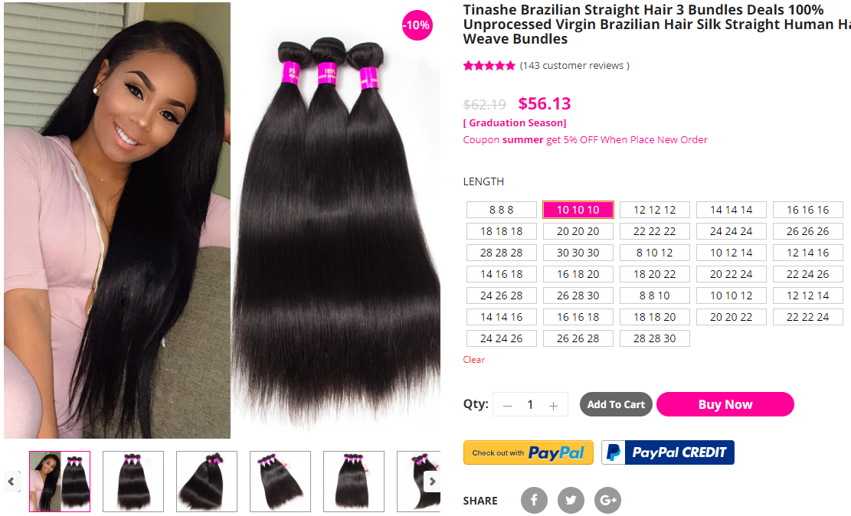
How to use Tinashe hair deals
This length 10 10 10
Origin Price : $62.19
Sale Price : 56.13
Choose any length
Please use Add To Cart
or Buy Now Button

Slide 3
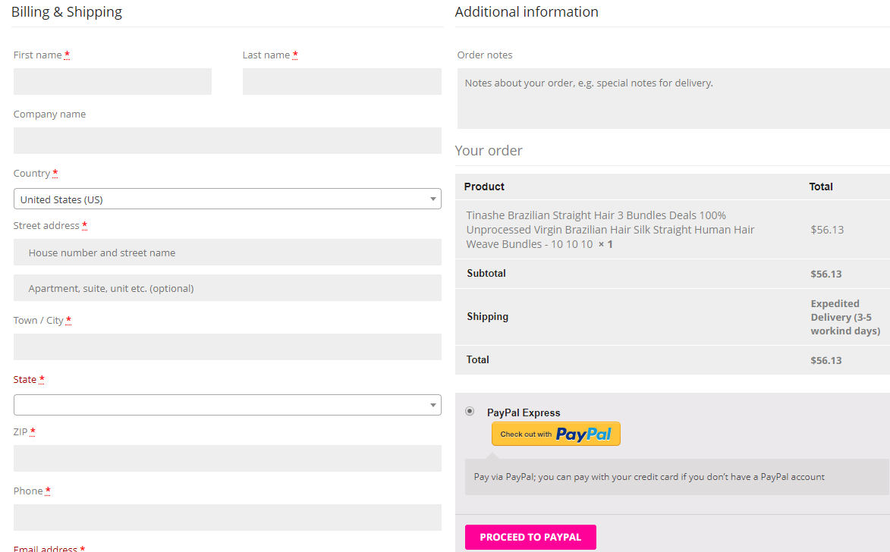
How to use Tinashe hair deals
Only sale price
Proceed your order, easy get your deals.

Slide 4
How to get Tinashe Hair coupon code
www.tinashehair.com Homepage banner
Tinashe hair Youtube channel, some video will have bigger coupon
https://www.youtube.com/c/tinashehair
Follow Tinashe hair Facebook and Instagram, from time to time, coupons will be released.
https://www.facebook.com/tinashehair
https://www.instagram.com/tinashehair/
https://www.pinterest.com/tinashehair/

Slide 5
How to use Tinashe Hair coupon code
This length 10 10 10
Origin Price : $62.19
Sale Price : 56.13
Choose any length
Please use Add To Cart
or Buy Now Button

Slide 6
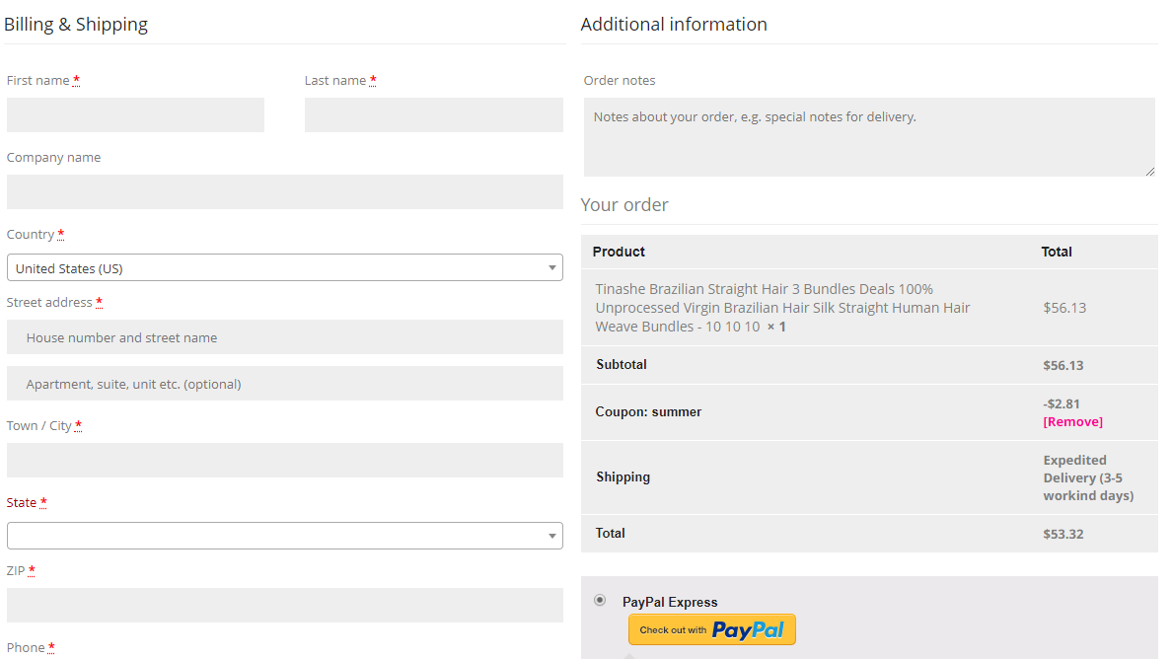
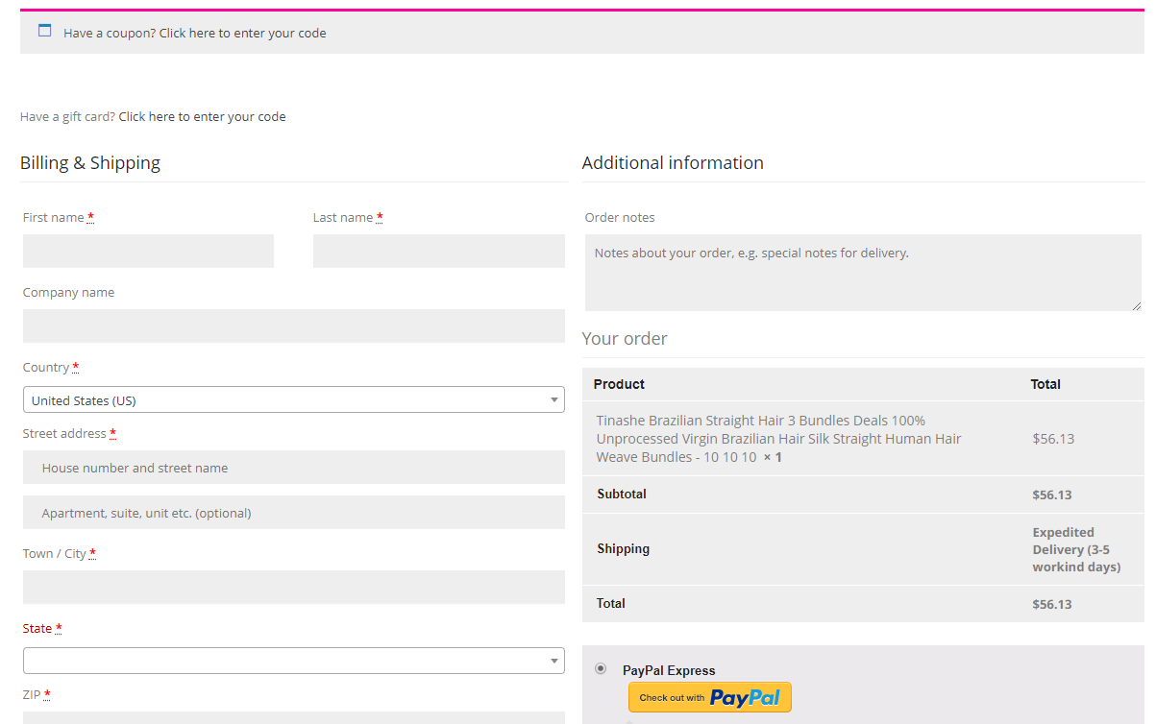
How to use Tinashe Hair coupon code
Enter you code
For example:summer
summer
Now you can see here have coupon code show: summer and have discount price -$2.81
Place your Order

