Slide 1
Refer a Friend
Earn No-limit $5 coupon
For each friend you invite, we will send you a $5 coupon code that you can use to purchase or get a discount on any product on our site
All your refer coupon can be used in conjunction with other referral coupons. It means you can use all your referral coupon in one order, if you have enough coupons, you might get free order.

Slide 2
How to Refer a Friend
How to refer in desktop
Get your refer link
How to use refer link
Check your refer coupon code
How to refer on your mobile
Get your refer link
How to use refer link
Check your refer coupon code

Slide 3
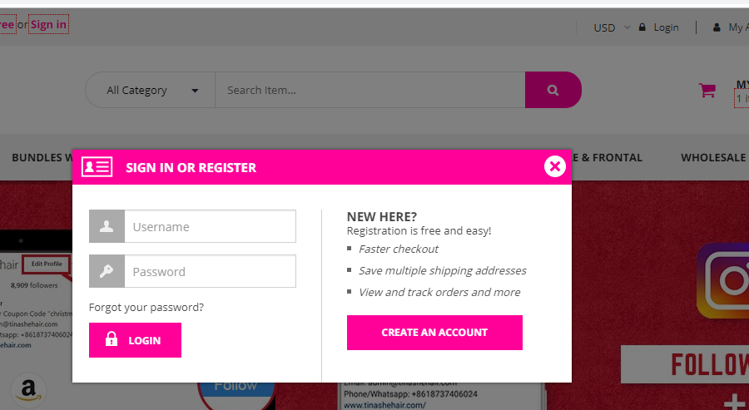
How to refer in desktop
First you need have an account on www.tinashehair.com
Also you can enter this link to register your account
https://www.tinashehair.com/my-account/
click Login butto, then will have a Pop-ups window
click CREAT AN ACCOUNT button

Slide 4
How to refer in desktop
Now login in your account
Here it would be shown you refer a friend information

Slide 5
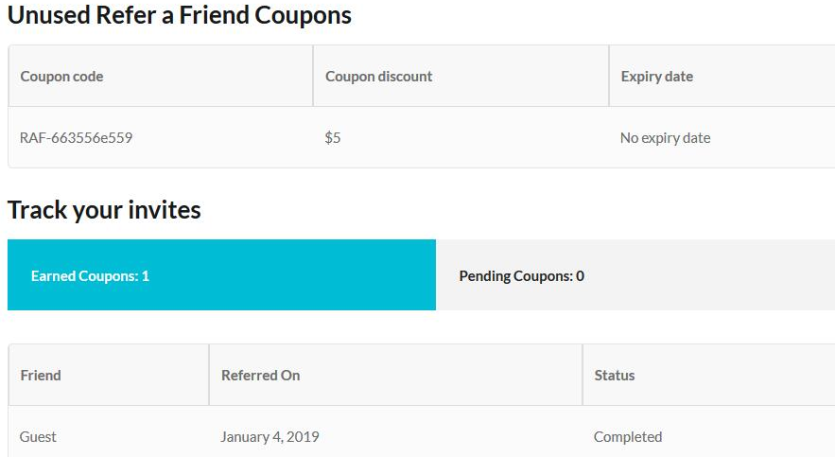
How to refer in desktop
You will get your Referral url
and your referral coupon code
Easy to copy your url link or coupon code, it is highly recommended to copy the refer url link to share.
Also can share link to your social media
you can send the link to your friends by email or message
If your friend place a order and completed, here will have coupons quantity
If your friend place a order but not completed, here will have pending coupons quantity

Slide 6
How to refer in desktop
Now share or send the refer link to your friend, when she place new order during in 15 days, after order completed, you will get a coupon code worth $5.
For each friend you invite, you will get one refer coupon, you can use your refer coupon together.
You can share your refer link by Facebook, Twitter, Instagram, Pinterest, Youtube or send by email etc...

Slide 7
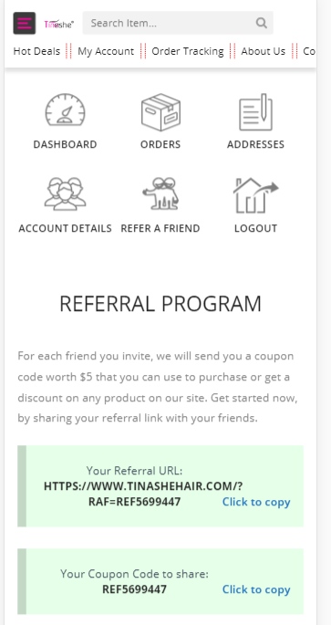
How to refer on your mobile
Open our site on mobile, login in your account
Here is refer a friend link
Easy to copy your url link or coupon code, it is highly recommended to copy the refer url link to share.

Slide 8
How to refer on your mobile
If you refer completed, your refer page will show informations about your coupon

